Slide 1
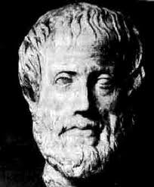
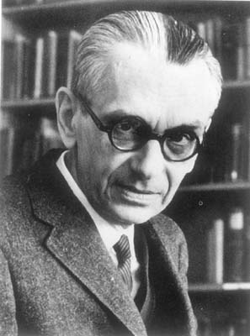
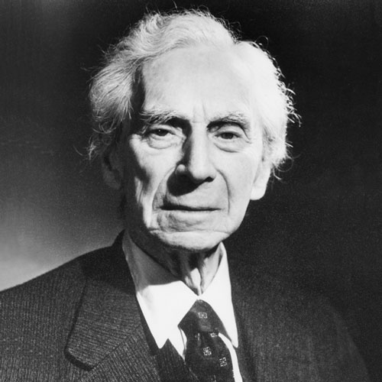
SOME DEFINITIONS CONCERNING LOGIC

Slide 2
Statement =_{df} a declarative sentence which is either true or false.

Slide 3
Explanation: A statement is something which might be used to express a (possible) belief. Fundamentally we are interested in finding out which beliefs are true and which are false.

Slide 4
Argument =_{df} a collection of statements one of which is designated as the conclusion of the argument. The rest are called the premises of the argument.

Slide 5
Explanation: An argument is an abstract representation of the reasons (beliefs or possible beliefs) [the premises] that might be offered in support of another belief [the conclusion], together with the belief.

Slide 6
Deductively valid argument =_{df} an argument which is such that it is not possible for the premises to be true and (at the same time) for the conclusion to be false.

Slide 7
Explanation: A deductively valid argument is one that has the strongest possible connection between premises and conclusion. However, the premises of a deductively valid argument need not be true (!)

Slide 8
Inductively strong argument =_{df} an argument which is such that (1) it is not deductively valid, and (2) it is improbable that the conclusion is false, given that the premises are true.

Slide 9
Explanation: If you suppose that you know only the premises of an argument (together perhaps with implicit common knowledge) and that would make it probable that the conclusion is true, then the argument is inductively strong. Inductive strength, unlike deductive validity, comes in degrees.

Slide 10
Cogent argument =_{df} an argument that is (1) either deductively valid or inductively strong, and is (2) such that its premises are known (or at least reasonably believed) to be true.

